Slide 1

Zero to 60+
Welcome!
Welcome

Slide 2
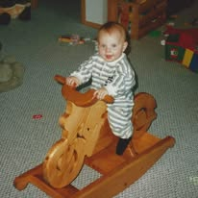
What IS an Aging Rider?
ME?

Slide 3
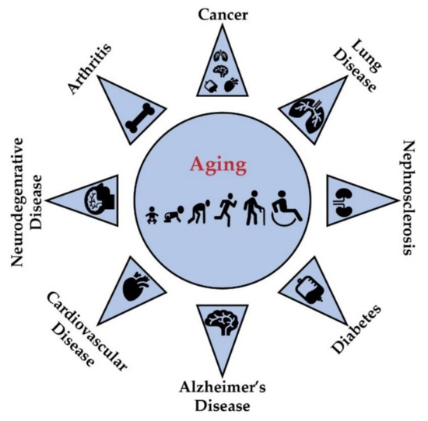
Physical

Slide 4
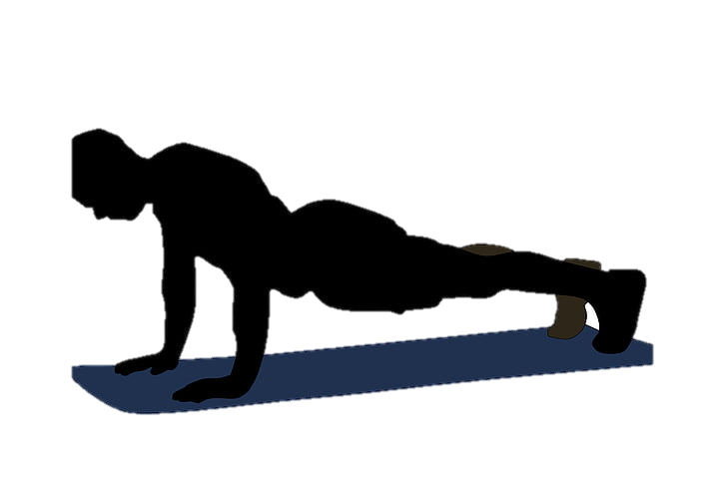
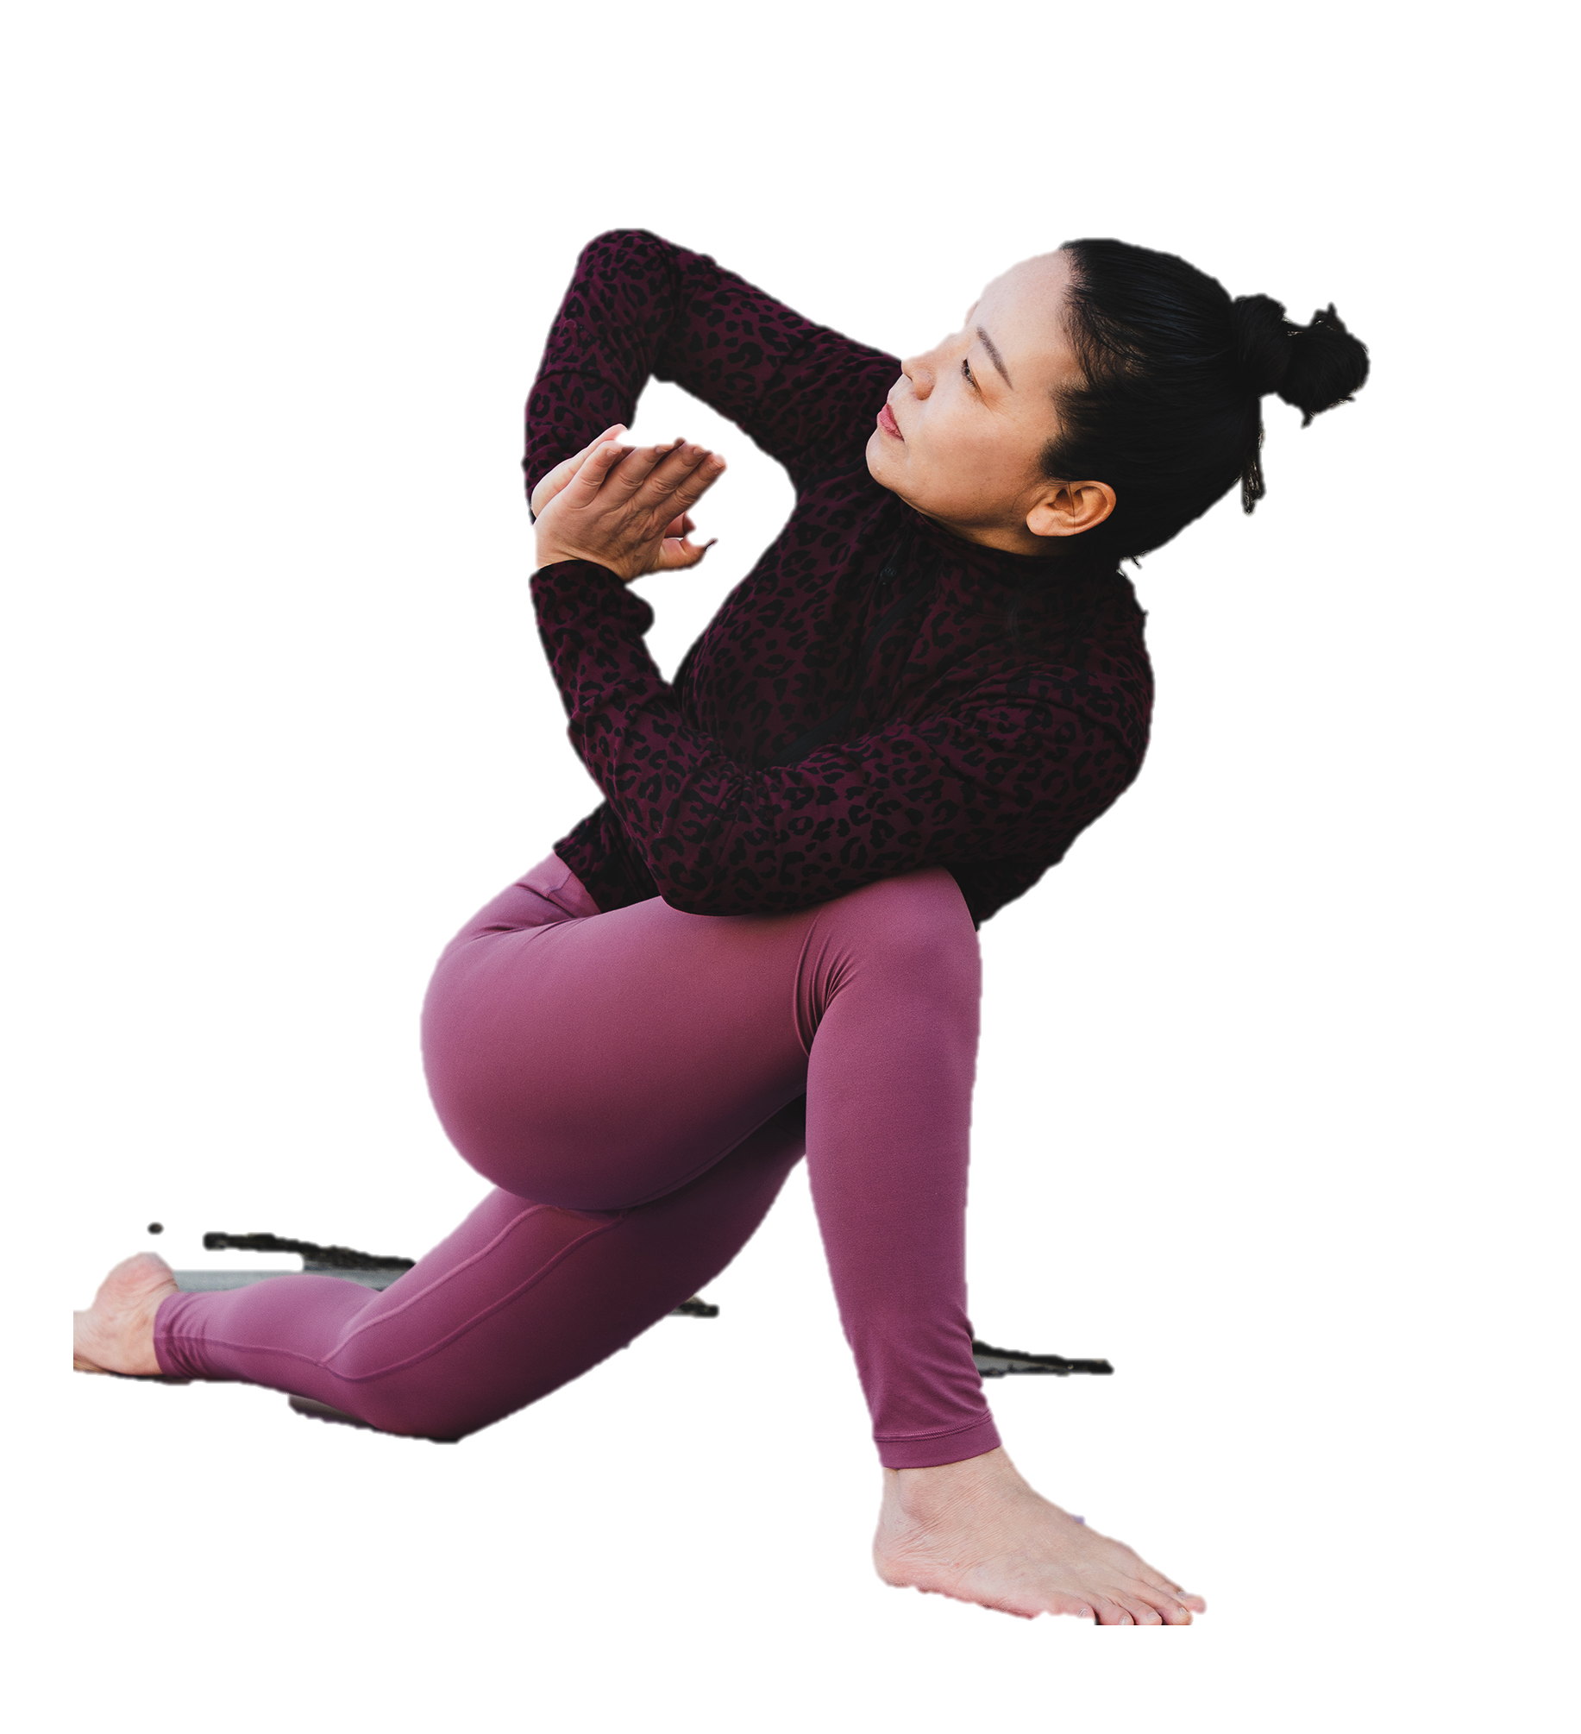
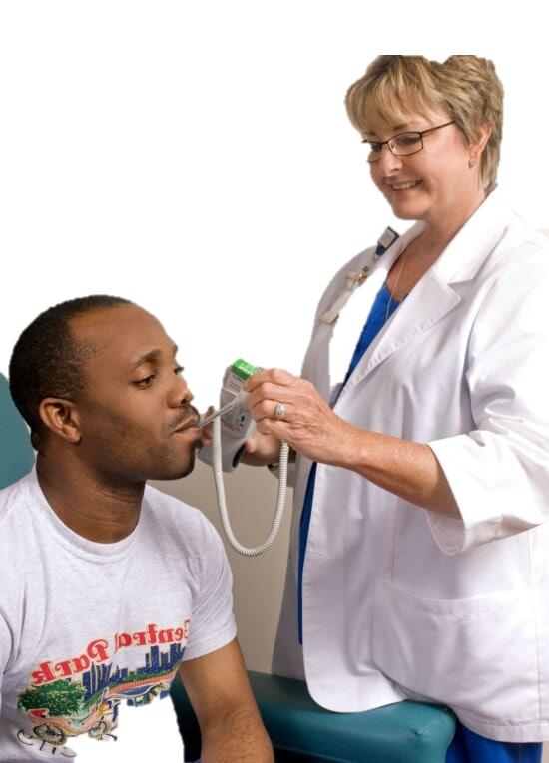
Fight Back

Slide 5
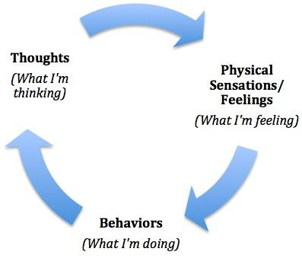
Cognitive

Slide 6




Fight Back

Slide 7
Environment
Change

Slide 8
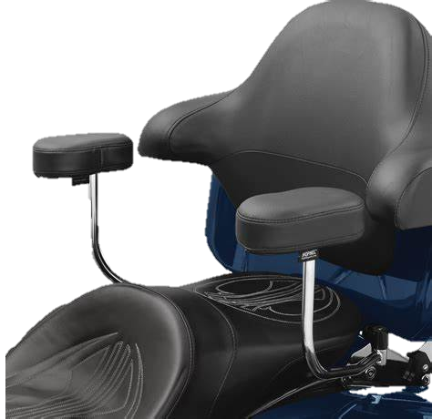
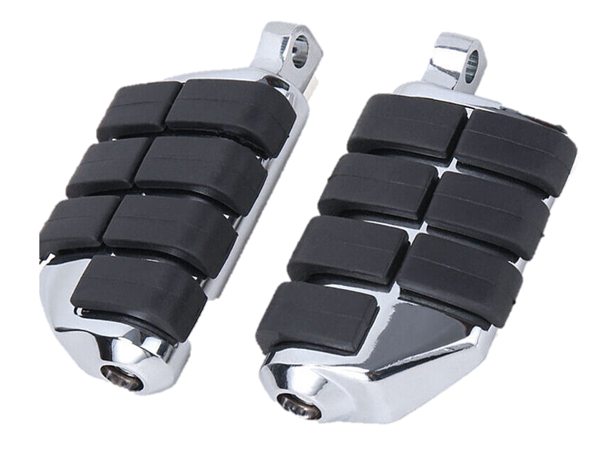
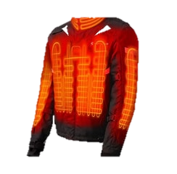
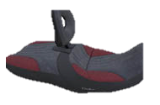

Fight Back

Slide 9
What else can you do??
Change YOU!

Slide 10
Thank you for attending

