Slide 1

Riding 2-Up
Welcome!

Slide 2
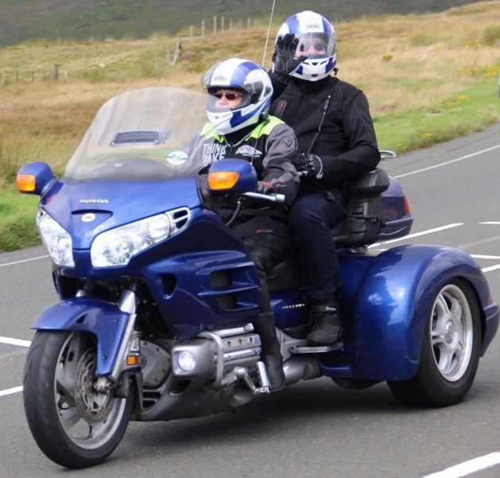
Riding 2-Up
OBJECTIVES
TO PROVIDE EDUCATION AND INFORMATION
BOTH THE DRIVER AND PASSENGER ARE RIDERS THAT WORK AS A TEAM
FOCUS ON THE PASSENGER PERSPECTIVE
TAKING OWNERSHIP OF THE JOURNEY
RIDING AWARENESS AND TEAM INTERACTION
REDUCING RISK
INCREASED RIDING ENJOYMENT!
2

Slide 3
This presentation will cover the following topics that are associated with the Passenger and Rider working together as a TEAM:
Prepare for the Ride
Planning, Packing, and Loading
Riding Gear
Communication
Riding Skills for the Passenger
Emergency!
Summary
Questions?

Slide 4
Prepare for the Ride
Passenger is Mentally & Physically Prepared
Motorcycle Prepared
    Vehicle Inspection Sheet
“It’s Your Life Too”

Slide 5
PLANNING, PACKING AND LOADING
Anticipate Needs
Riding Gear
Balance Load
Trailering

Slide 6
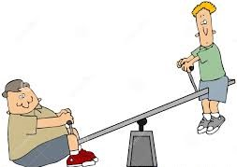
PLANNING, PACKING AND LOADING
Balancing the Load
(Optional Discussion)

Slide 7
RIDING GEAR
A.T.G.A.T.T----------What is it? WHY?
Riding Gear....It’s a Personal Choice!

Slide 8
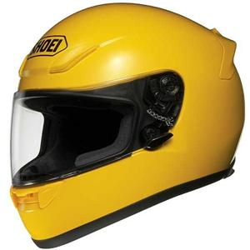
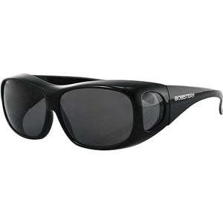
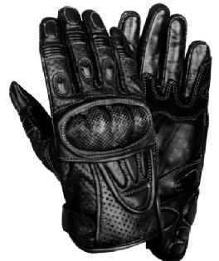

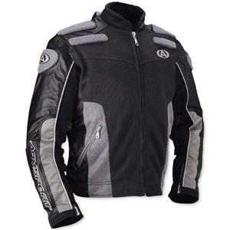
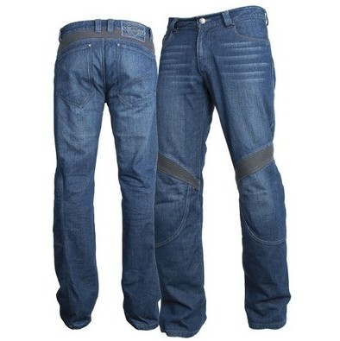
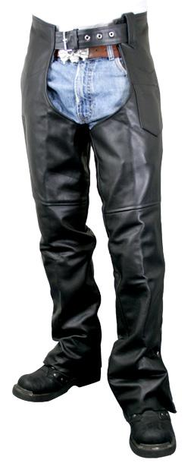
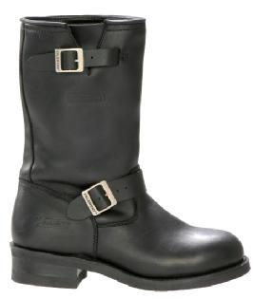
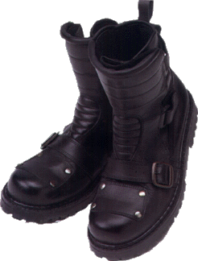
Riding Attire - A Personal Choice
Notes:
What are “ALL THE GEAR” components? (Blank slide)
*Glasses/Face Shield/Goggles
*Gloves—full fingered
*Long Sleeves—not pull on sleeves
*Long Pants
*Footwear—over the ankle – Boots preferred
*Helmet:
*DOT or ECE APPROVED
*Outer shell—only good for one impact. It is designed to dissipate impact forces.
*Comfort liner – most snap out for cleaning.
*Compressible Styrofoam liner-cushions the head upon impact.
EXPIRATION DATE- found on chin strap OR under comfort and Styrofoam liners. Styrofoam liner degrades after approx. 5 - 7 years of sun exposure, heat, or use.

Slide 9
COMMUNICATION with Passenger
ACTION BASED
INFORMATIONAL BASED
DISCUSSION BASED

Slide 10
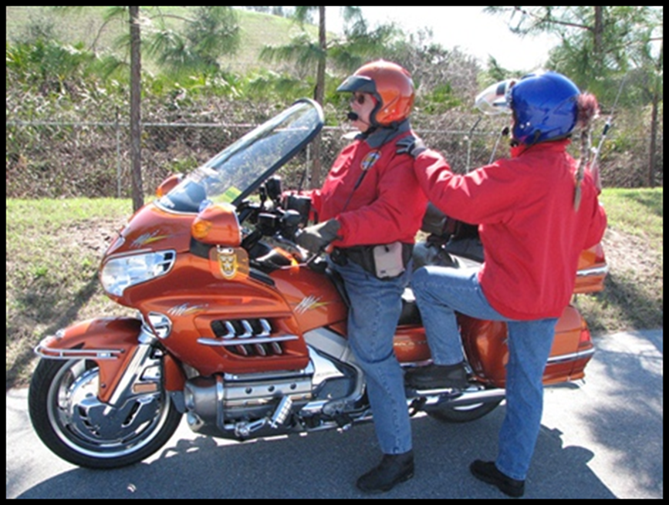
COMMUNICATION
Action Based
Any movement or change initiated by either Passenger or Rider.
*In general, it’s OK to shift positions, stretch or shake your legs. But, let the rider know. Sudden moves cause imbalances.
.

Slide 11
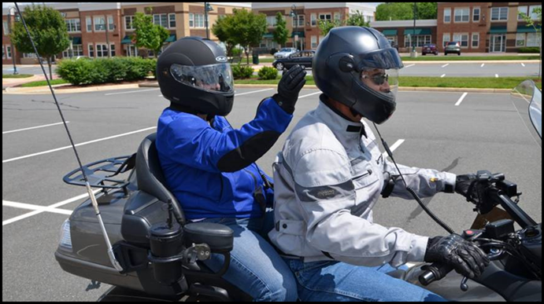
Riding 2-Up
This is NOT an ACTION BASED communication!
REALLY?? Is there no other way to communicate?
Please, no helmet slaps—it’s SO distracting and DANGEROUS!

Slide 12
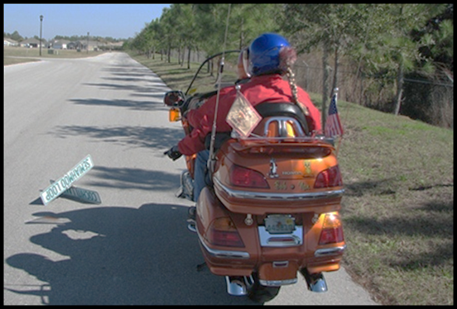
Communication
Informational Based
Has direct effect on the ride
Passenger identify hazards and poor road conditions to those following.
Communicate personal needs.
Communication goes both ways.
Change of route.
Need to form a new plan.
How can YOU make the ride safer and more FUN?

Slide 13
Communication
Discussion Based
General conversation
Should be extremely limited using the CB
Should never interfere with Information communication
Never impact Emotional state of the bike’s TEAM

Slide 14
RIDING SKILLS for the Passenger
Passengers need specific skills to be effective as a Team member.
Straight Line
Cornering
Braking
Swerving
THESE SKILLS TAKE PRACTICE!

Slide 15
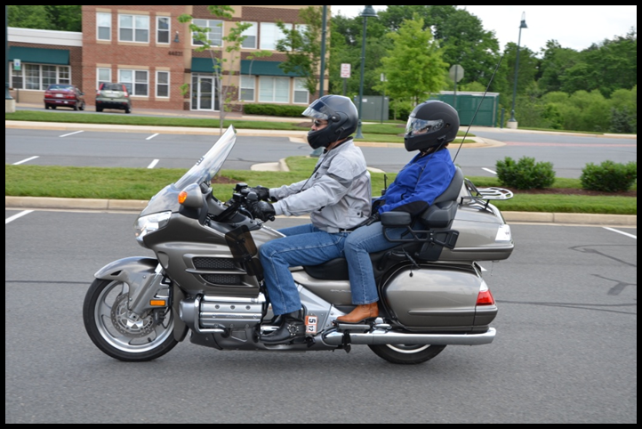
Straight Line
Proper riding position:
Feet on foot boards
Hands on thighs or passenger handholds
Press with legs

Slide 16
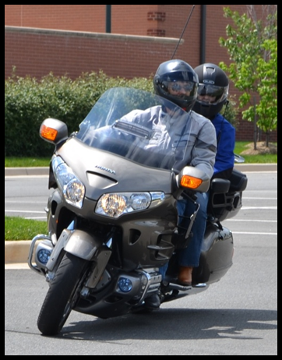
Cornering
Proper riding position:
    Look through the corner
    Lean with the bike
    Don’t counterbalance

Slide 17
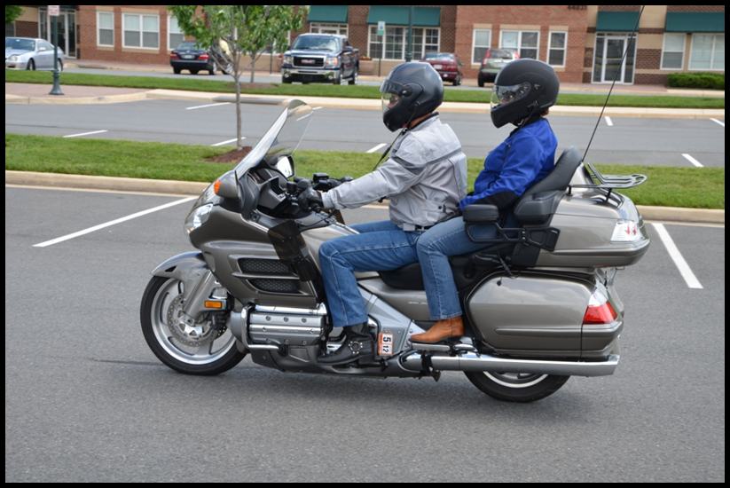
Braking
Proper riding position:
  Brace feet, knees and hands
  Sit upright and lean slightly back

Slide 18

Swerving
Proper Riding Position:
Move slightly forward
Let the bike move under you
Don’t flop like a rag doll

Slide 19
EMERGENCY
Recognize Crisis
Take Action
Controls in an Emergency
Stopping the Bike
Call/Signal for Help

Slide 20
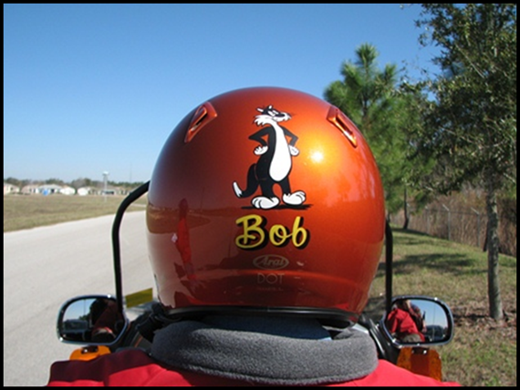
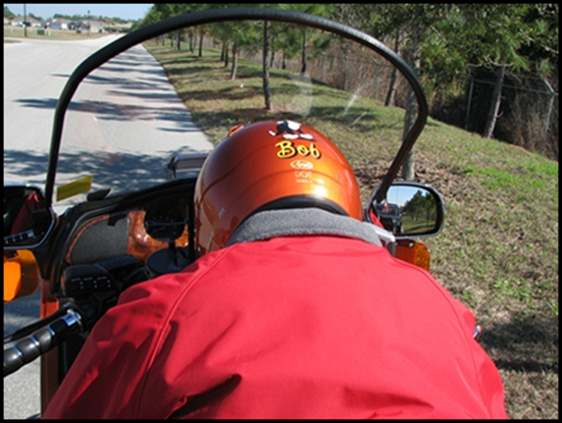
The Passengers View
You begin your ride with this view
What if your view turns into this?
You may NOT have begun the ride wanting to be the driver!

Slide 21
Rider in Crisis
Heart Attack
Heat Stroke
Stroke
Foreign Object to the Eye/Face
Diabetes Complications
Others?

Slide 22
TAKE ACTION
Take Control of Motorcycle
Stay Calm.
Get control of the motorcycle.
Push the rider forward onto the tank. Stand up, if necessary, to reach the handlebars.
Engage the “Cut off Switch”.
Keep your head up—steer away from center line and traffic!
Look toward a safer place for the motorcycle to fall over.
Keep your Arms, Legs and Feet in.
You and the Motorcycle will fall over.

Slide 23
Controls in an Emergency
Unfamiliar with Controls?
Where can you find the answers?
  Owner’s Manual
  Controls are unique to the vehicle you ride.
  Visual Observation of your bike.
  Ask your Rider.

Slide 24
Motorcycle Controls
Engine Cut Off Switch
Clutch
Brake
CB

Slide 25
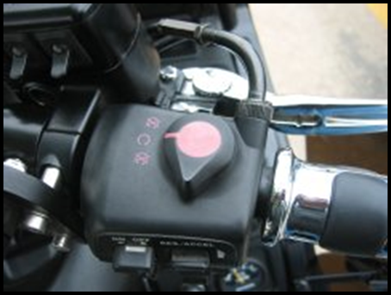
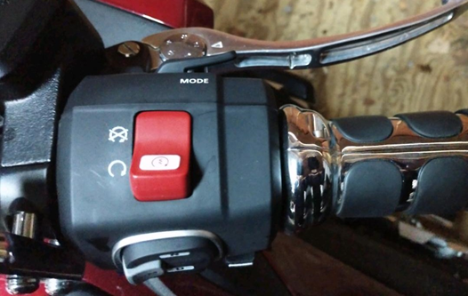
Engine Cut-Off Switch
GL 1800 (2001-2017)
GL 1800 (2018)

Slide 26
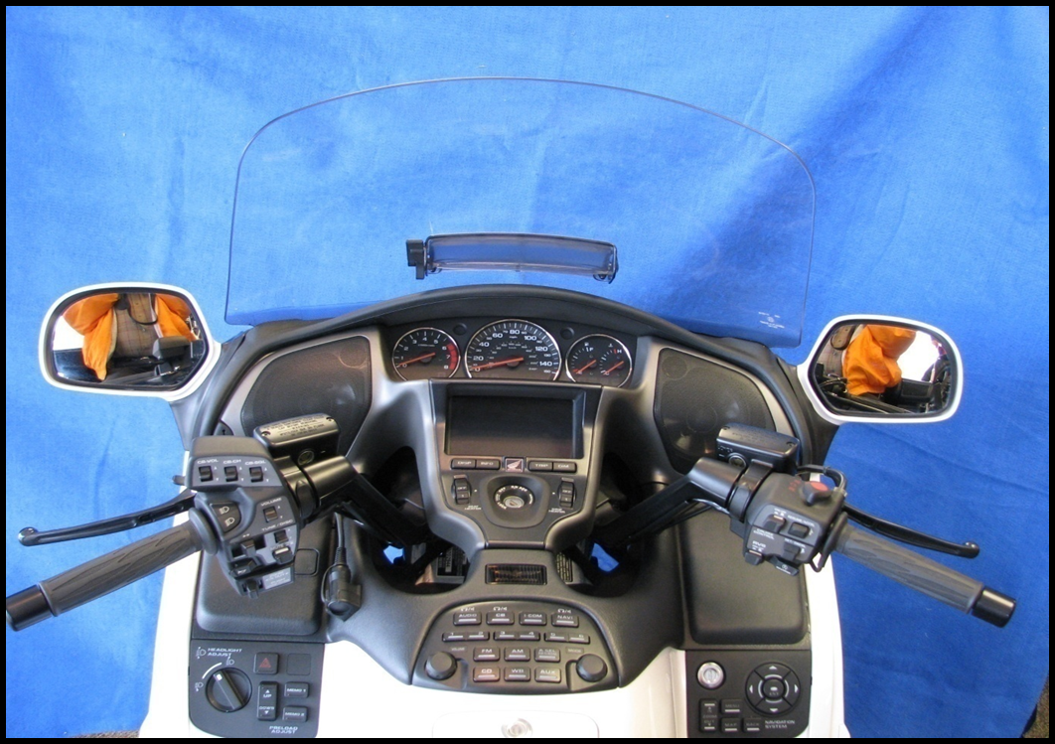
Brake, Clutch, and CB Switch

Slide 27
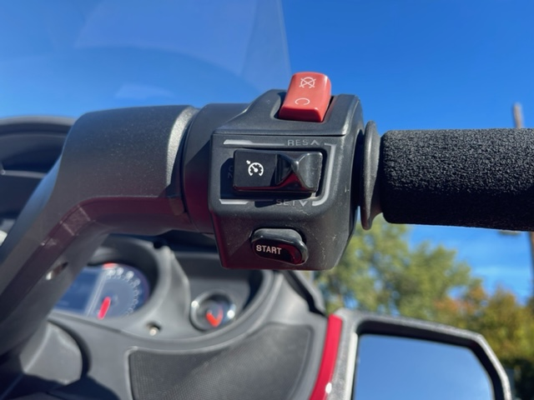
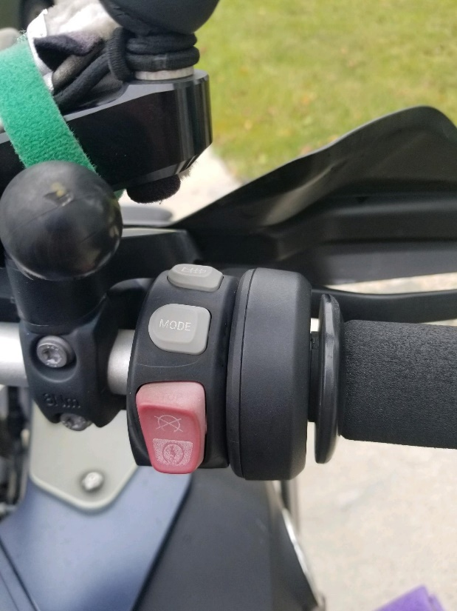
Engine Cut-Off Switch
Can Am
BMW

Slide 28
GETTING STOPPED
Get control / Grasp handgrips
Use Engine Cut-Off Switch
DO NOT touch brake or clutch levers
Keep head up and look well ahead
Keep arms, legs, and feet tucked in
Bike will quickly slow
Let it fall over
You cannot hold a Motorcycle up!

Slide 29
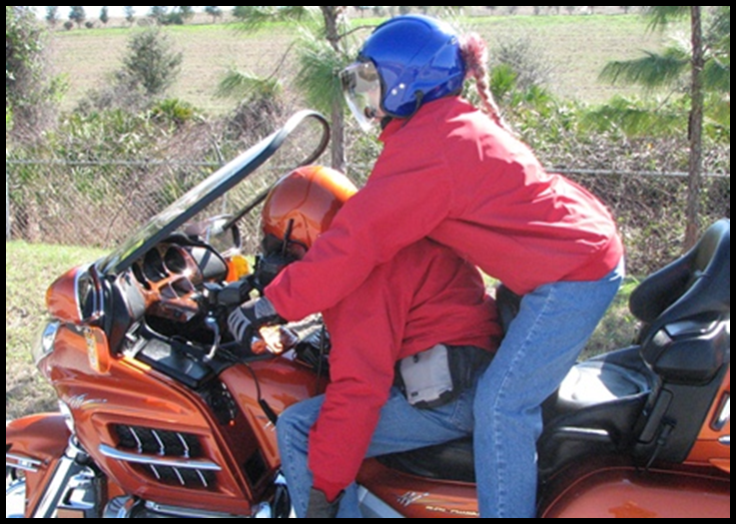
Remember…
You ARE a trained Passenger
Passengers make a difference!

Slide 30
Call/Signal for Help
First, check YOURSELF!
Get assistance for the RIDER
  Cell Phone – 911
  CB
  Universal Helmet Signal
Emotional Considerations

Slide 31
SUMMARY
Prepare for the Ride
Planning, Packing and Loading
Riding Gear
Communication
Riding Skills for the Passenger
EMERGENCY!
Summary
Questions

Slide 32
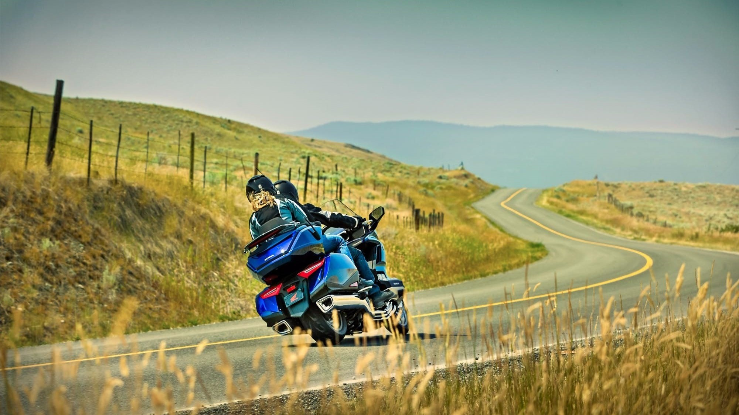

Thank you for attending.

